Slide 1
Solar panel installation and bulk purchase program

Slide 2
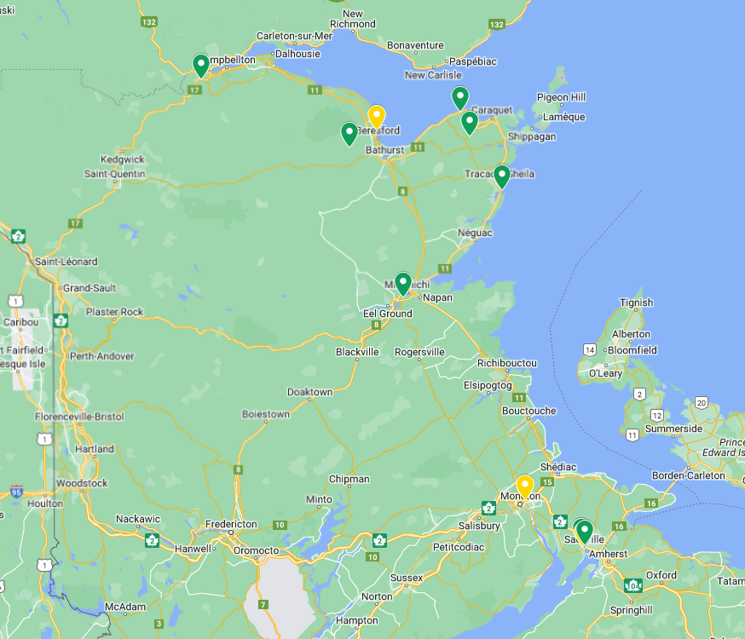
Systems Mapping
Ground Installations
Roof Installations
4

Slide 3
Systems type with number of panels
226
Ground Installations
54
Roof Installations

Slide 4
KPI DASHBOARD
68 Preliminary Analysis
11 systems planned for 2023
203 385 kWh
159 Tons of CO2/year
Done through the program
Acquisition ratio 16%
Saved per year
Equivalent to
+ $23.000 in savings
Equivalent to greenhouse gas emissions from:
575 791km driven by an average gasoline-powered car
Equivalent to CO₂ emissions from:
14 159 gallons of diesel consumed
72 335 pounds of coal burned

Slide 5
Savings realized by the Program Participants: + $30 000 average of $2727 per system (including the free analysis –Bulk program discount - …)

